Slide 1


DATA ANALYSIS ON TOP 500 FORTUNE COMPANIES.
TEAM MEMBERS:
M. SPANDANA DEVI
K. SREEVANI KEMPEGOWDA

Slide 2
About me
Name : Spandana Devi .M
(B.Sc. (Chemistry)., M B.A (pursuing))

Slide 3

INTRODUCTION
Ambition Box was started in 2015 by two IIT Madras alums with the goal to help job seekers prepare for interviews. We grew from 0 to 1.5 Lakh users/month in 1.5 years and became one of the most loved platforms for interview prep in the country.
Ambition BOX has morphed from a small startup in an apartment to 40+ employees today that serve more than 85 Lakh users every month. Special thanks to our growing list of contributors without whom we could not have existed.

Slide 4
PROBLEM STATEMENT:
To gather data on the top 500 fortune companies. After collecting the data , analyzing the top companies which offers great salary and also analyzing the ratings and review of the top 500 companies.
OBJECTIVE:
Analyzing and identifying the companies which are very good for working and having an excellent salary and also having a good ratings and review and their jobs requirement.

Slide 5



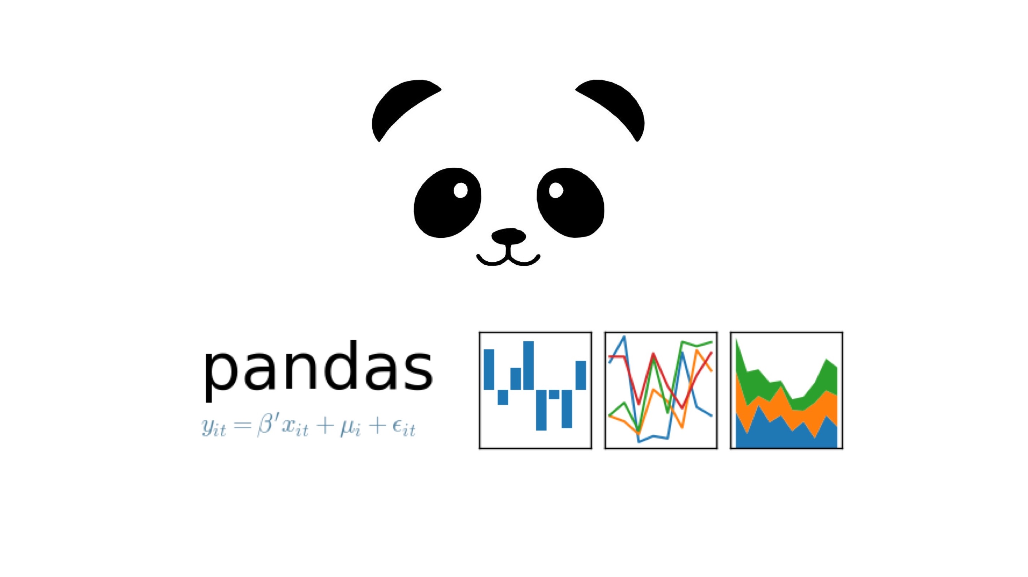

LIBRARIES USED:
Beautiful Soup
Requests
Regex (re)
Pandas
Matplotlib
Seaborn

Slide 6
WEB SCRAPPING:
Web Scrapping Is an automatic way to retrieve unstructured data from a website and store them in a structured format.
STEPS:
Taking the website that you want to work.
Access the URL of website using code and download all
the HTML contents on the page.
Find out the request-response that gives you the data
that you want.
Depending on the type of request(post or get)simulate
the request in your code and retrieve the data from API
Extract out useful info that you need.

Slide 7
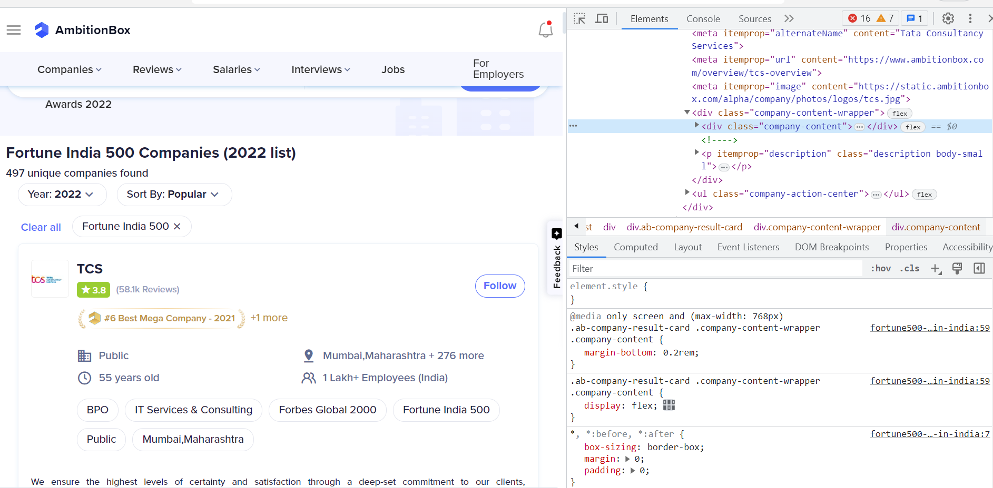
DATA COLLECTION
Used Website:https://www.ambitionbox.com/fortune500-companies-in-india
Here, we have used this website to get the data.

Slide 8
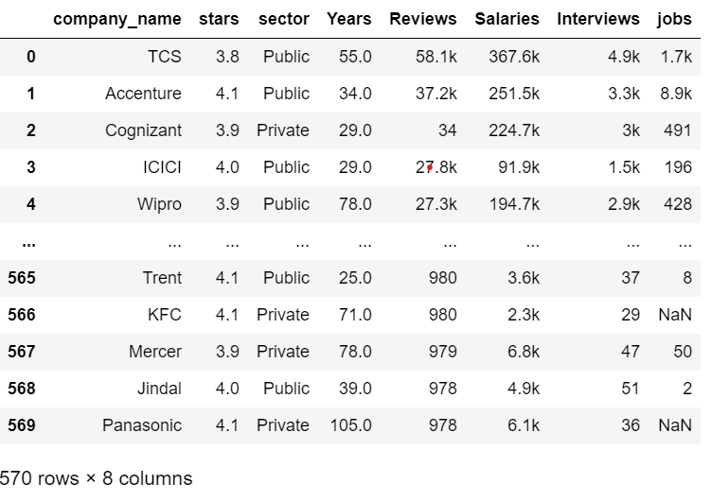
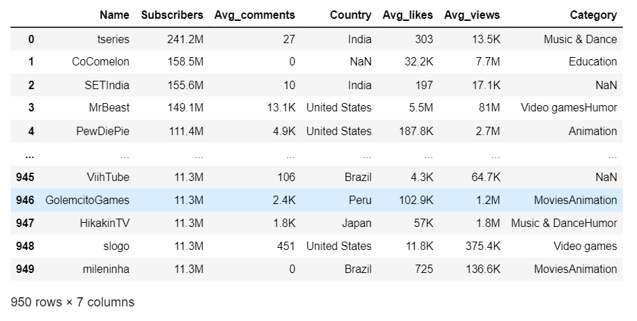
RAW DATA :
This is the collected Raw data.

Slide 9
DATA CLEANING STEPS ::
Removing special characters and converting types.
Searching for missing and nan values and filling them with the techniques.
Searching for Duplicate Values.
Finding Outliers and removing
The Final Data Structure is with 570 rows and 8 columns

Slide 10
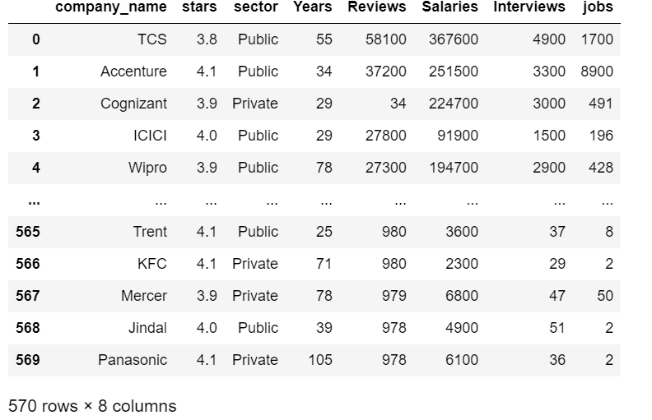
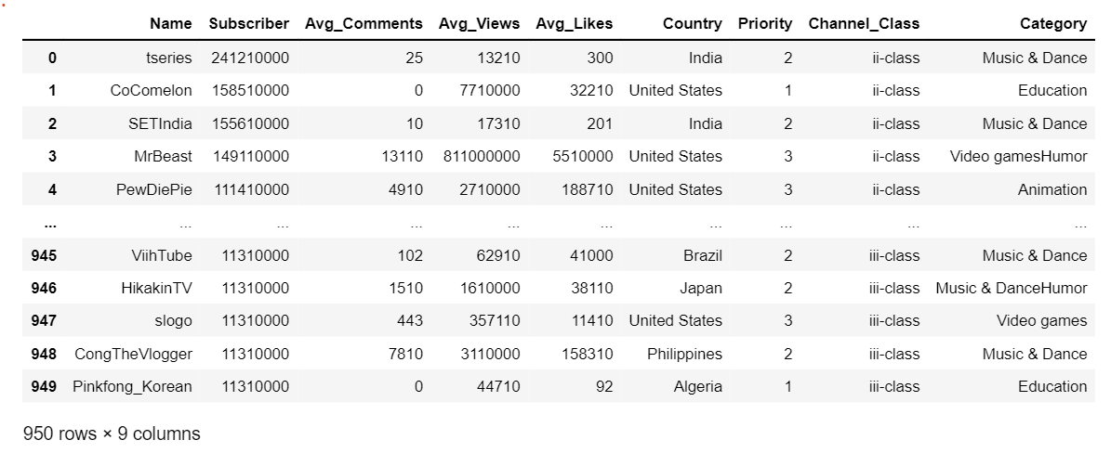
FINAL DATA AFTER CLEANING:

Slide 11
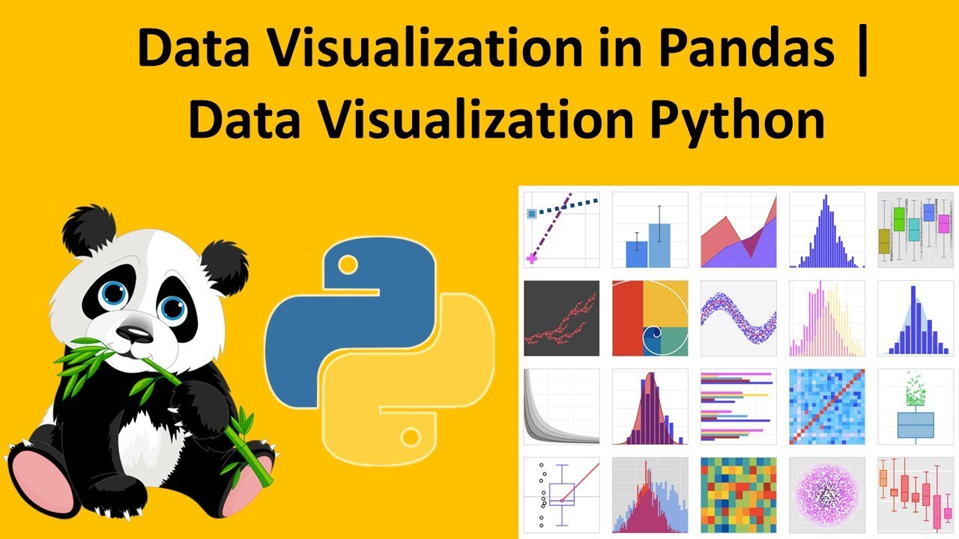
DATA VISUALIZATION:
It is a graphical representation for analyzing complex data, identifying patterns and extracting valuable insights

Slide 12
EDA and SEABORN:
Matplotlib and Seaborn are python libraries that are used for data visualization. They have inbuilt modules for plotting different graphs
We perform the data visualization in 3 ways:
UNI-VARIATE ANALYSIS
BI-VARIATE ANALYSIS
MULTI-VARIATE ANALYSIS

Slide 13
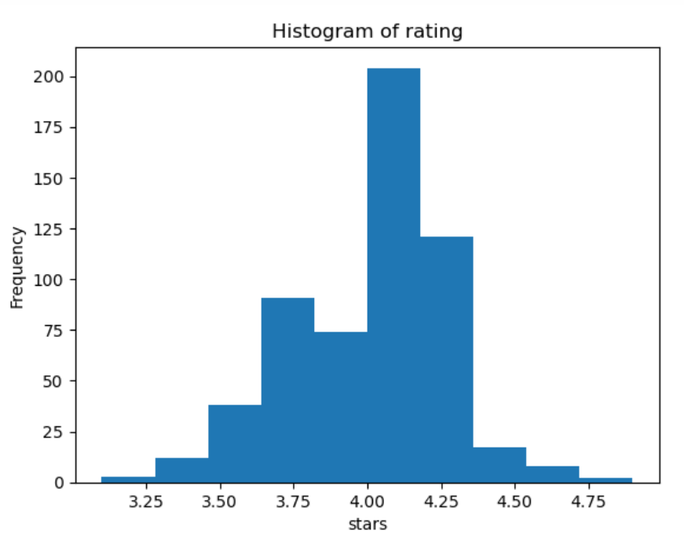
ANALYSIS ON :
Here in this hist-plot we observed companies on the basis of ratings

Slide 14
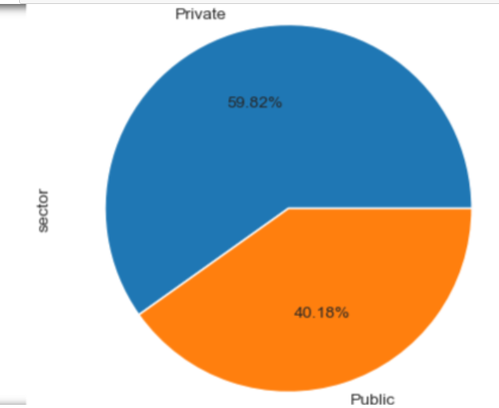
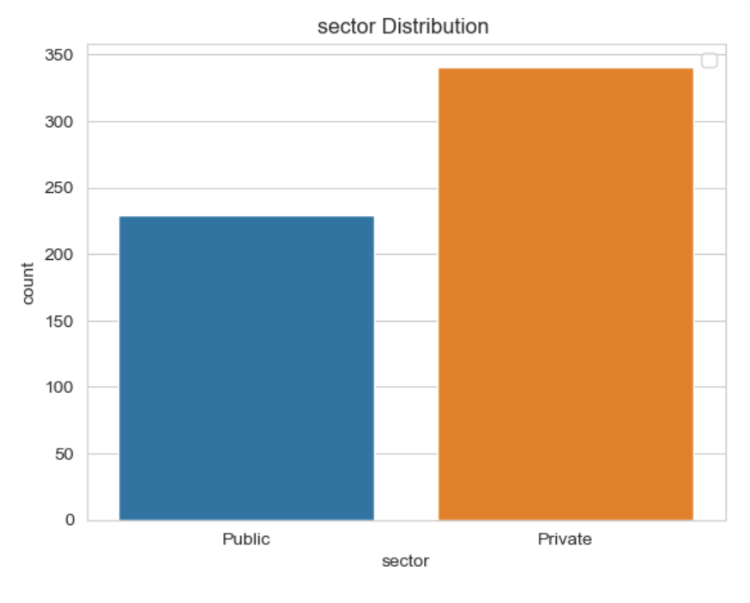
Analysis on companies on sectors:
observation:
The majority of companies in the dataset belong to the private sector it is indicated by the largest slice in the count plot.
public sector companies also have a significant presence but are relatively less compared to the private sector
.

Slide 15
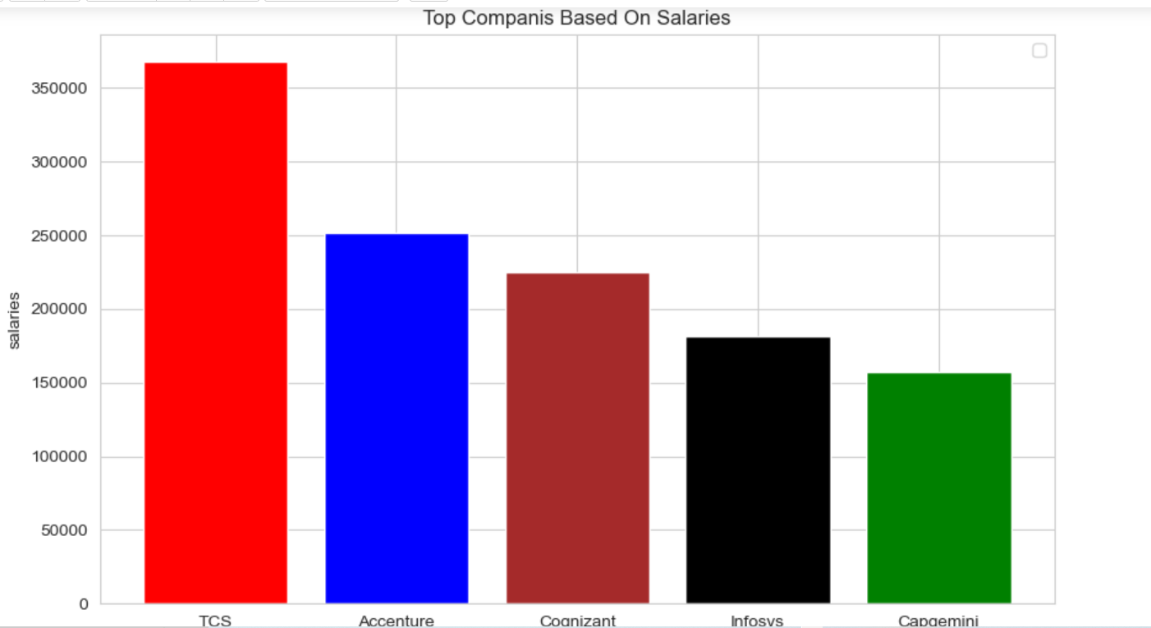
Analysis on salary of top 5 Companies
There are 5 top companies which are good in providing salary . Named as TCS , Accenture , Cognizant , Infosys , Cap Gemini.

Slide 16
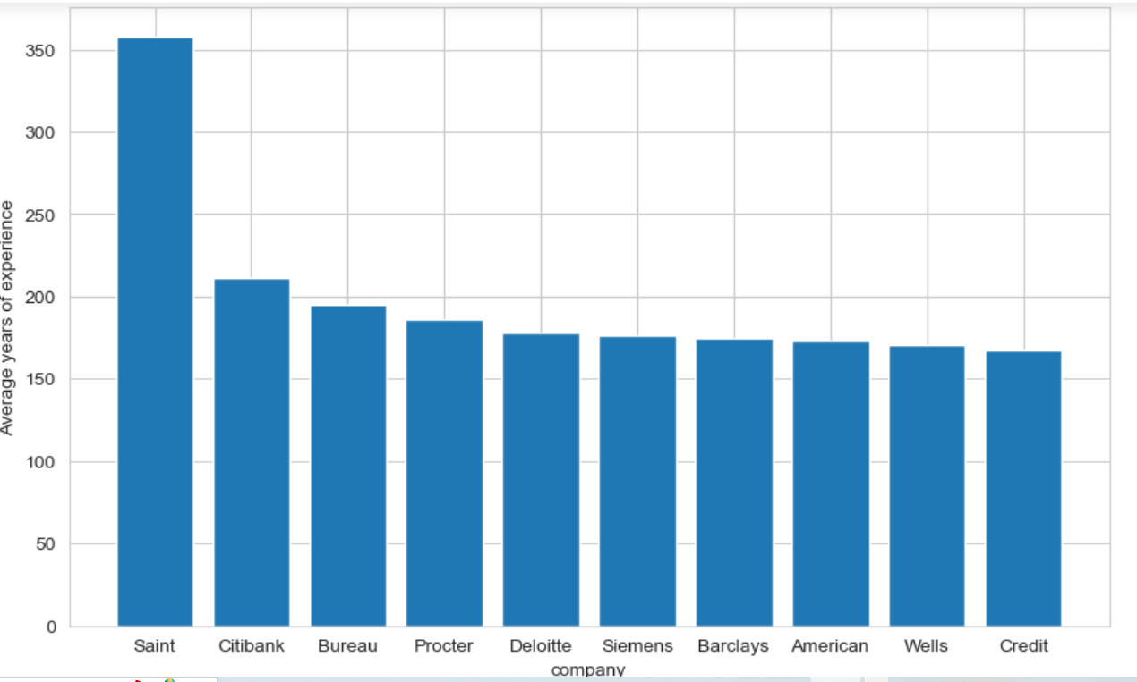
Analysis of years and experiences
observation:
if we observe this box plot shows top companies based on years of experience "saint" company have more than 350 experience

Slide 17
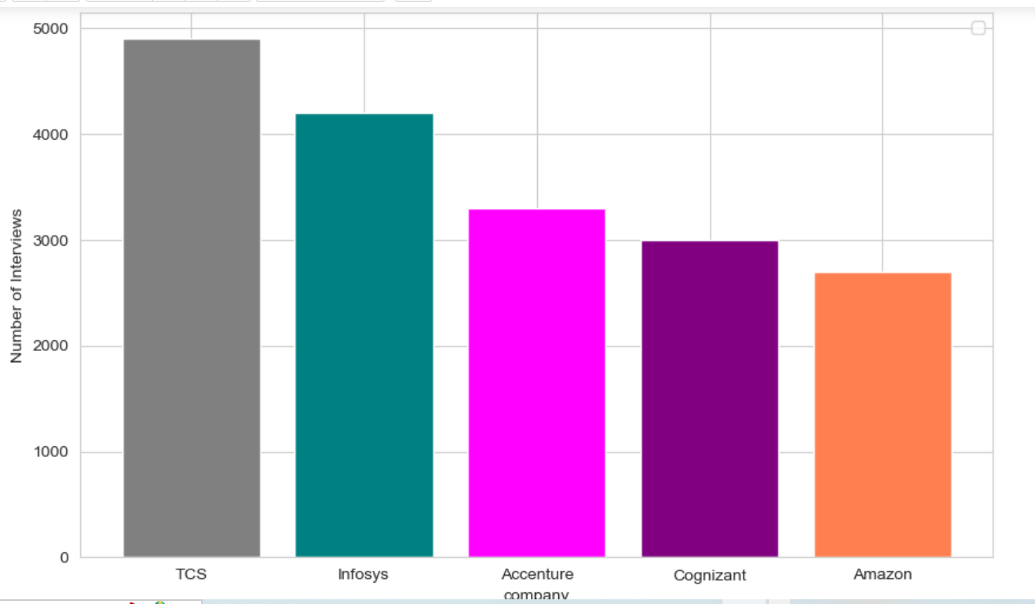
Analysis on Companies based on interviews

Slide 18
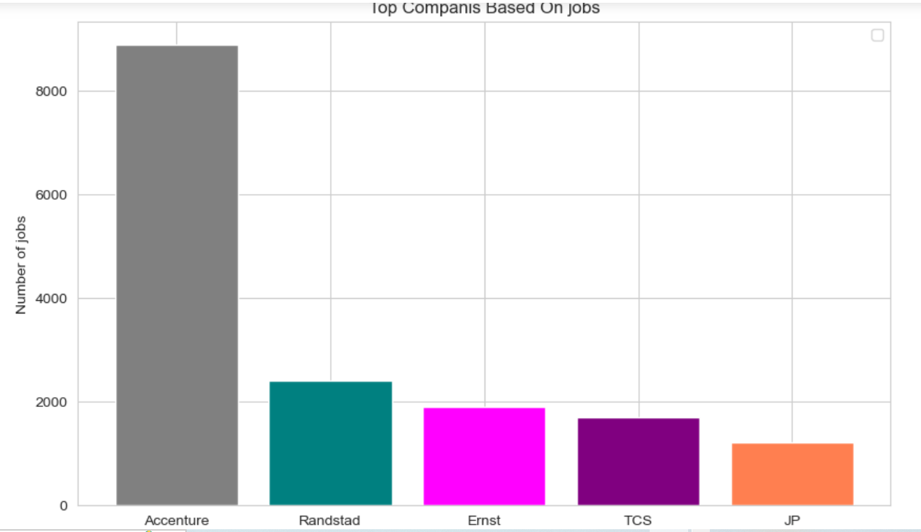
Analysis on companies on basis of jobs

Slide 19
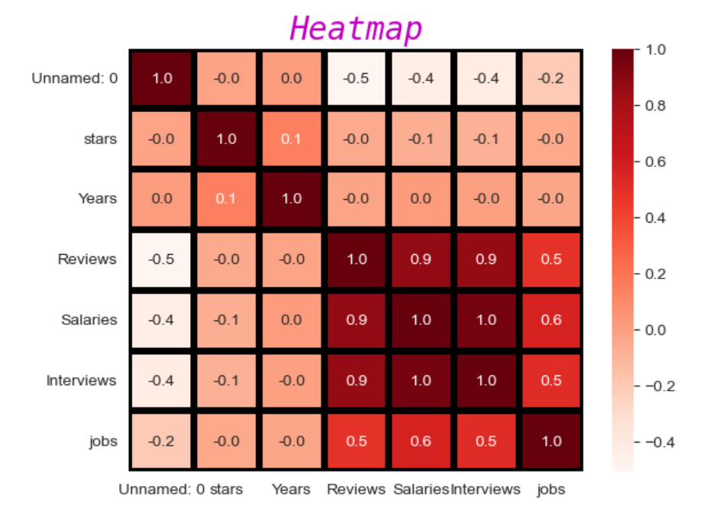
Correlation Distribution of Numerical Columns:
Observation:
Heat map shows interviews and salaries have strong positive correlation
Jobs and salaries have weak positive correlation.

Slide 20
CHALLENGES FACED:
To search the website (or) to take a perfect URL, it took lot of time.
We faced more Challenge while Collecting the data from Website
Cleaning of data

Slide 21
Conclusion:
From the observations , I can see that TCS is the best company to work with .
jobs and salaries have weak positive correlation
Heat map shows interviews and salaries have strong positive correlation
top companies based on years of experience "saint" company have more than 350 .

Slide 22


